Slide 1
02
Social psychology
Psicología social

Slide 2
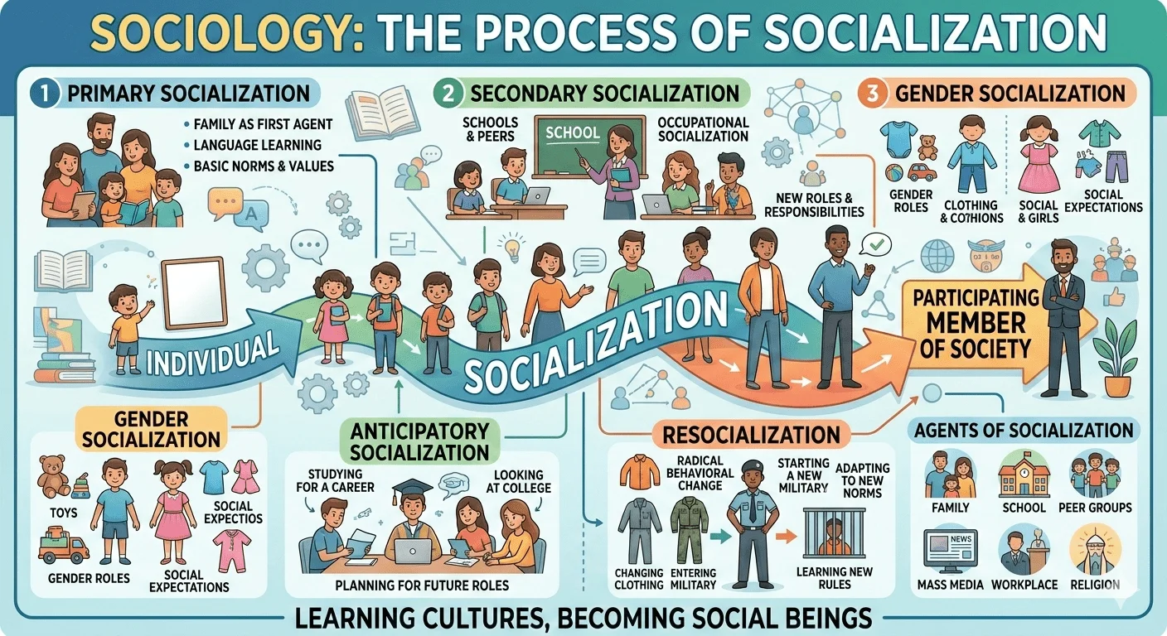
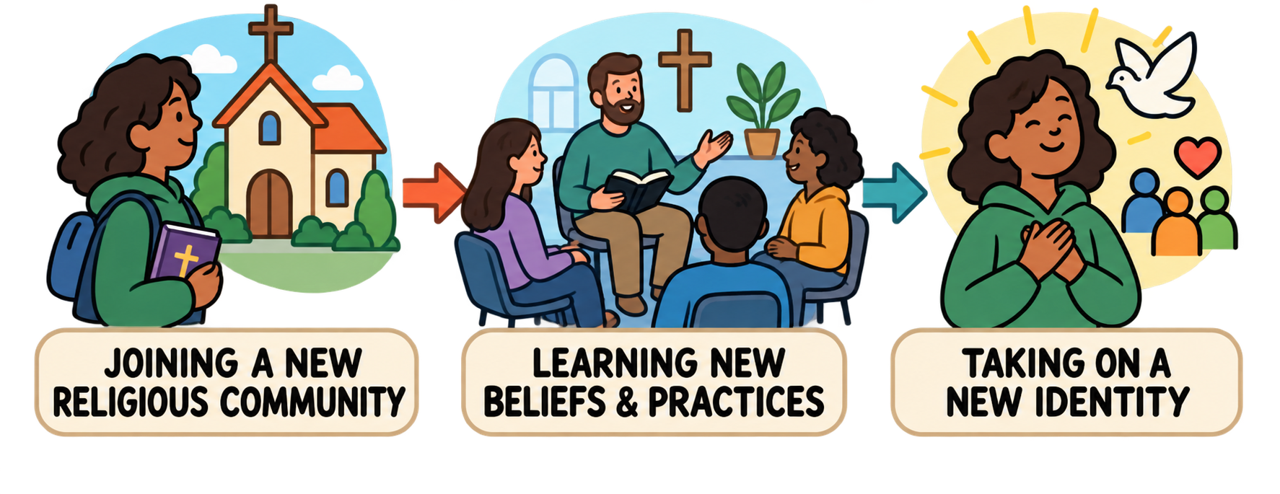
Socialization Socialización
The process of learning how to fit into society: learning the language, rules, and codes of behavior that a particular culture considers normal
El proceso de aprender a integrarse a la sociedad: aprender el idioma, las reglas y los códigos de conducta que una cultura en particular considera normales
2. Socialización secundaria
• Escuela y compañeros
• Socialización laboral
1. Socialización primaria
• La familia
• Aprendizaje del lenguaje
• Normas y valores básicos
3. Socialización de género
• Ropa y colores
• Juguetes
Resocialización
• Aprender nuevas reglas
• Aprender nuevas creencias
• Asumir una nueva identidad
Socialización anticipatoria
• Planear roles futuros
Notes:
Primary socialization: This type of socialization happens when a child learns the values, norms and behaviors that should be displayed in order to live accordingly to a specific culture. Primary socialization takes place during infancy, childhood and early adolescence, in which an individual builds their basic core identity and personality. Primary Socialization is the learning we experience from the people who raise us.
EXAMPLE: A child hears his father hold the door for an old lady. The child learns that this behavior is socially acceptable, so he starts holding the door for older people.
Secondary socialization: This type of socialization occurs when a person learns an appropriate behavior to be displayed within a smaller group which is still part of a larger society. The changes within the values, attitudes and beliefs of an individual are seen to be less important than the changes made in him as he participates in the larger society. Secondary socialization is usually associated with teenagers and adults, and involves smaller changes than those occurring in primary socialization. Secondary socialization takes place outside the home.
EXAMPLE: A child being educated in school. A high school graduate chooses a career in cooking after spending time with chefs
Anticipatory Socialization: Anticipatory socialization is the process, facilitated by social interactions, in which non-group-members learn to take on the values and standards of groups that they aspire to join, so as to ease their entry into the group and help them interact competently once they have been accepted by it. Anticipatory socialization is defined as accepting and incorporating the norms and values of a group that we anticipate joining in the future. This type of socialization refers to the process wherein a person practices or rehearses for future social relationships. In Anticipatory socialization adolescents not only learn their immediate group culture but also learn the culture of a group which they are expecting to join in future.
EXAMPLE: A child anticipates parenthood as she observes her parents perform their daily roles
Resocialization: This type of socialization involves rejecting previous behavior patterns and accepting new ones so the individual can shift from one part of his life to another. Resocialization is said to be happening throughout human life cycle. If socialization is the lifelong process of learning the values and norms of a given society, then resocialization refers to undergoing this process again by drastically changing one's values and beliefs. Typically, this occurs in a new environment where the old rules no longer apply. Resocialization is a process in which a person is taught new norms, values, and practices that foster their transition from one social role to another.
EXAMPLE: Military basic training is a good example. The recruit not only has to set aside civilian habits and adopt new behaviors to function as a soldier, but must also accommodate the new norms required of military life.

Slide 3
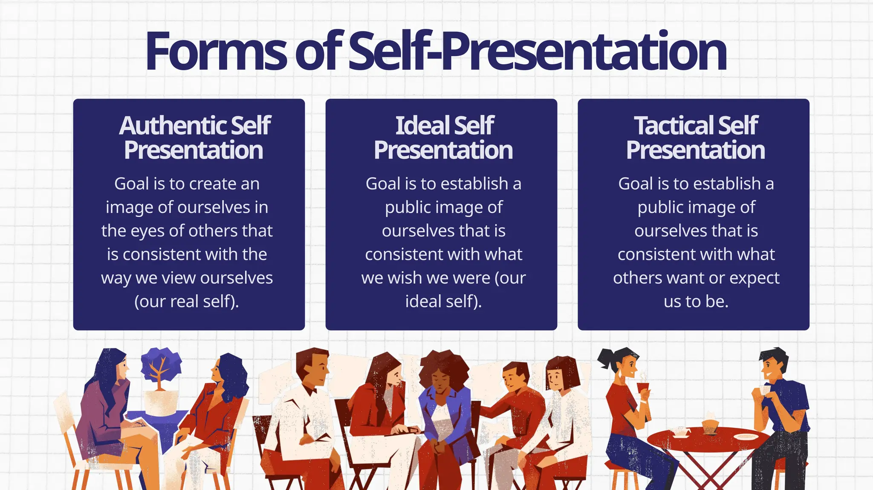
Self-presentation Autopresentación
How we shape the way others see us by choosing what to show and how to act
Cómo moldeamos la manera en que los demás nos perciben, eligiendo qué mostrar y cómo actuar
Autopresentación auténtica
El objetivo es crear una imagen de nosotros mismos ante los demás que sea congruente con la forma en que nos vemos a nosotros mismos (nuestro yo real).
Autopresentación ideal
El objetivo es establecer una imagen pública de nosotros mismos que sea congruente con lo que desearíamos ser (nuestro yo ideal).
Autopresentación táctica
El objetivo es establecer una imagen pública de nosotros mismos que sea congruente con lo que los demás quieren o esperan que seamos.
Notes:
The term self-presentation refers to the processes by which individuals attempt to control the impressions that others form of them in social interaction. The individuals involved may be aware of these processes or not. For certain purposes, it is useful to distinguish between authentic self-presentation, ideal self-presentation, and tactical self-presentation.

Slide 4
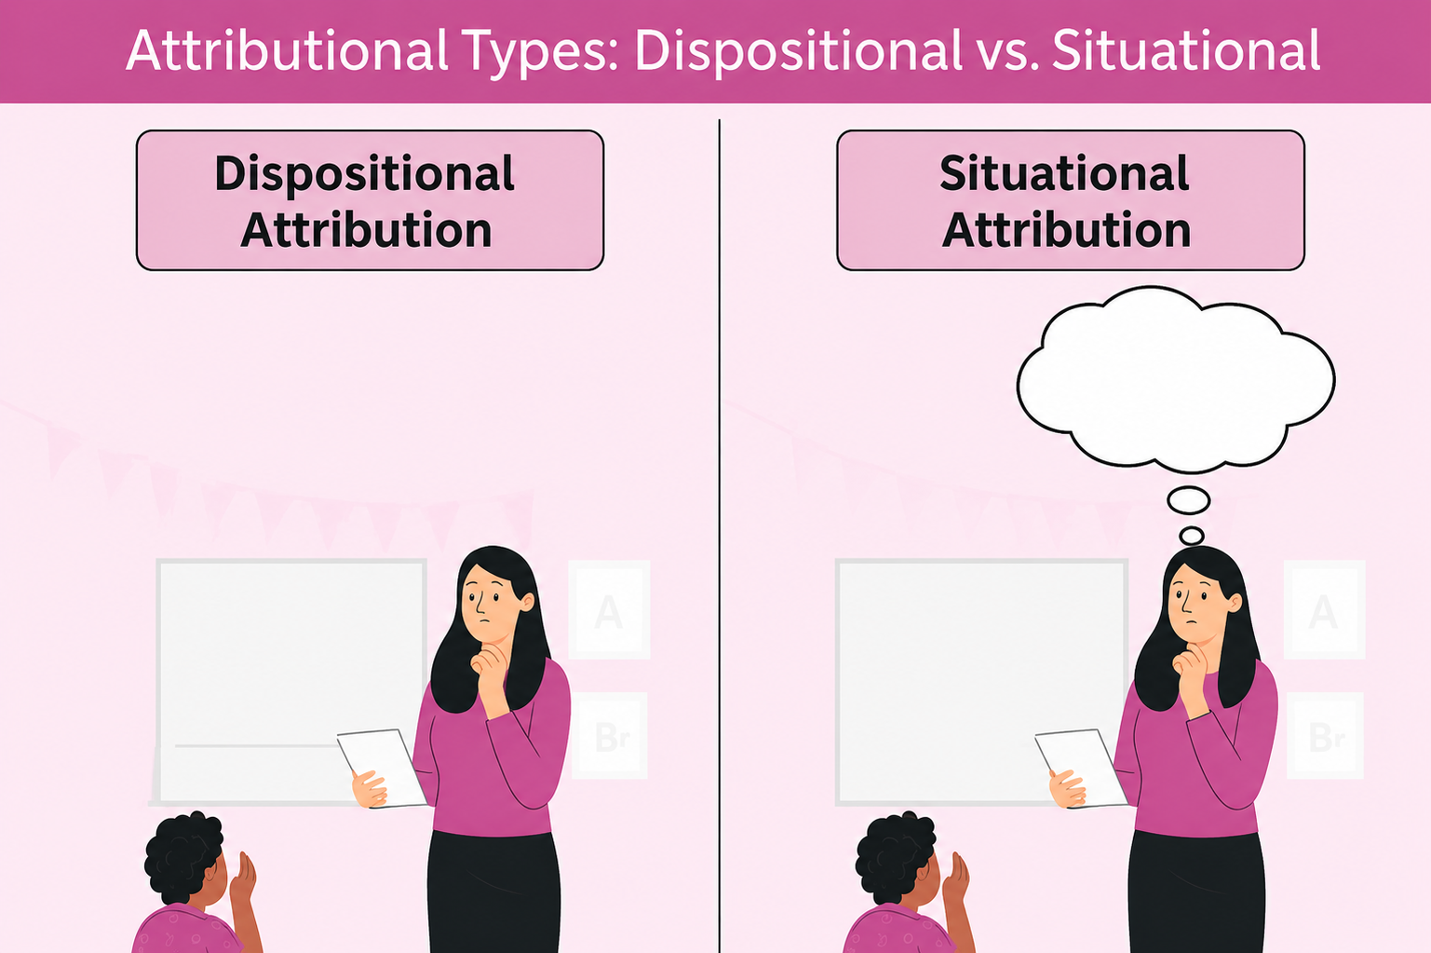
Attribution Atribución
How we decide why people do what they do, and the ways we judge others differently than ourselves
Cómo decidimos por qué las personas hacen lo que hacen, y las maneras en que juzgamos a los demás de forma diferente que a nosotros mismos
People attempt to understand events and actions by attributing intentions, beliefs, and feelings to the events
Las personas intentan comprender los eventos y las acciones al atribuirles intenciones, creencias y sentimientos
Actor-observer bias: we tend to explain our own behavior by situational factors, and others behavior by dispositional factors
Sesgo actor-observador: tendemos a atribuir nuestro propio comportamiento a factores situacionales, y el de los demás a factores disposicionales
Atribución disposicional
Atribución situacional
So late!
Could be trouble at home
So late!
Lazy child!
¡Qué tarde! ¡Niño flojo!
¡Qué tarde! Tal vez tiene problemas en casa.

Slide 5
Prosocial behavior and the bystander effect
Conducta prosocial y el efecto espectador
Prosocial behavior: actions that are intended to help others without expecting anything in return
Example: donating blood
Can be motivated by empathy, moral values, or a desire for social approval
Conducta prosocial: acciones que tienen la intención de ayudar a los demás sin esperar nada a cambio
Ejemplo: donar sangre
Puede estar motivada por la empatía, los valores morales o el deseo de aprobación social
Bystanders go through a 5-step process, during each of which they can decide to do nothing
Los espectadores pasan por un proceso de cinco pasos, y en cada uno de ellos pueden decidir no hacer nada
1. Notice the event Notar el evento
The bystander effect: when there is an emergency, the more bystanders there are, the less likely it is that any of them will help
El efecto espectador: cuando ocurre una emergencia, cuantos más espectadores haya, menos probable es que alguno de ellos ayude.
2. Interpret it as a problem Interpretarlo como un problema
3. Assume responsibility Asumir la responsabilidad
4. Know how to help Saber cómo ayudar
5. Act: Help! Actuar: ¡ayuda!

Slide 6
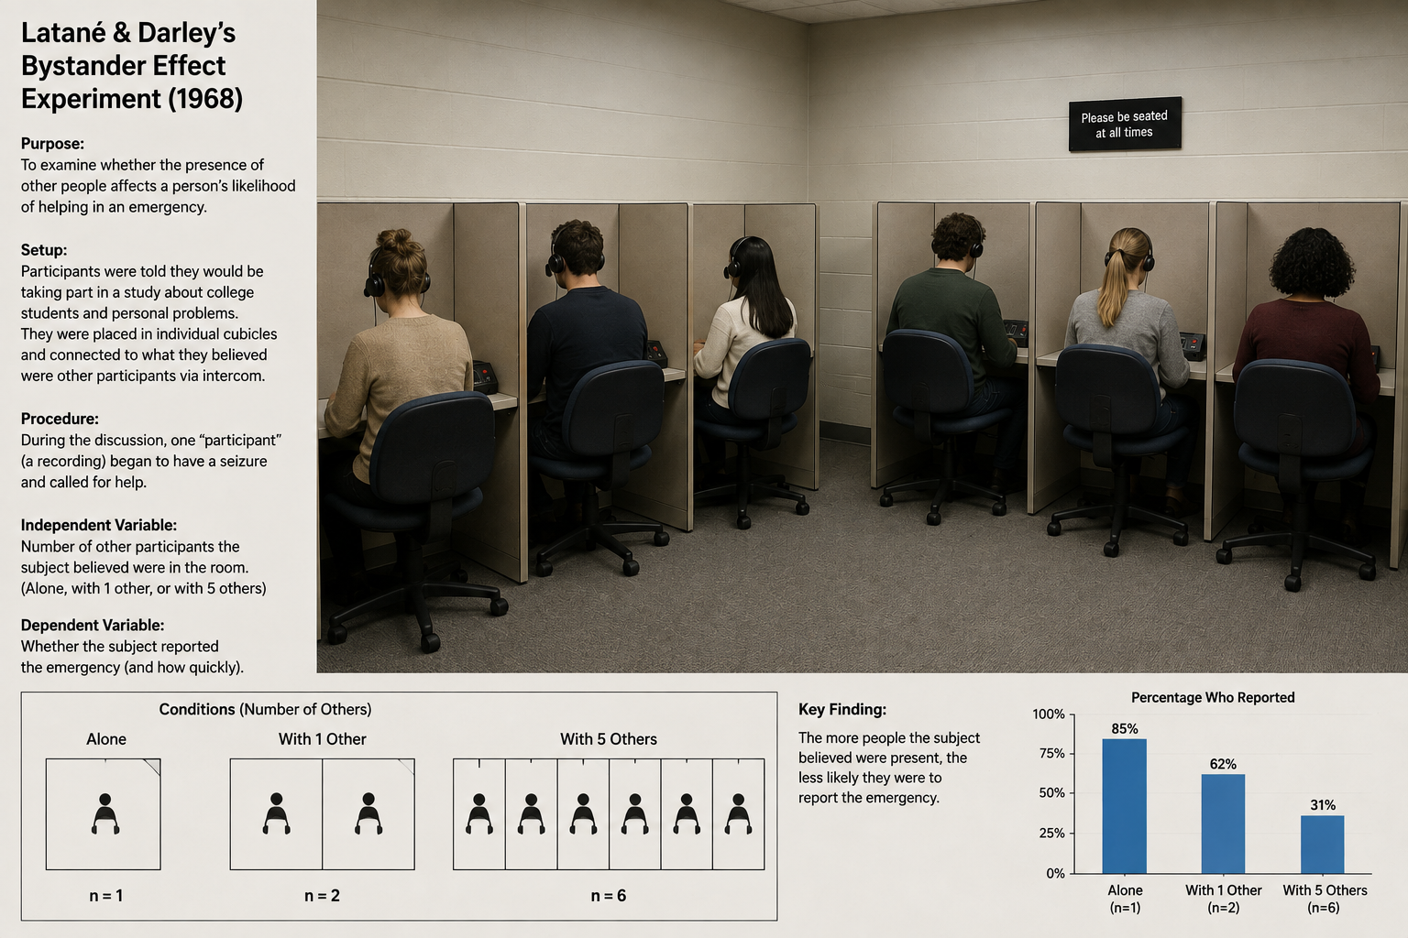
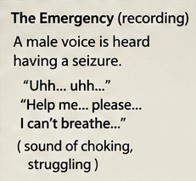
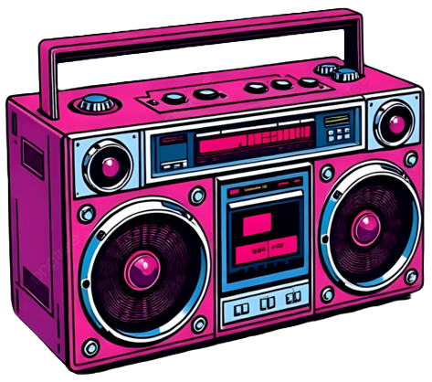
The bystander effect experiment
El experimento del efecto espectador
In 1968, Bibb Latané and John Darley ran an experiment where people were placed in separate cubicles and told they were taking part in a survey
En 1968, Bibb Latané y John Darley realizaron un experimento en el que las personas fueron colocadas en cubículos separados y se les dijo que iban a participar en una encuesta.
At one point, a tape recorder in the room started playing the sound of someone choking
De repente, una grabadora en la sala comenzó a reproducir el sonido de alguien ahogándose
Latané and Darley wanted to study how likely people were to get up and help
Latané y Darley querían estudiar qué tan probable era que las personas se levantaran a ayudar
Why???
Diffusion of responsibility (“Someone else will help”)
Looking to the crowd (“Maybe this isn’t an emergency?”)
¿¿¿Por qué???
Difusión de responsabilidad ("Alguien más ayudará")
Mirar a los demás ("¿Tal vez esto no es una emergencia?")

Slide 7
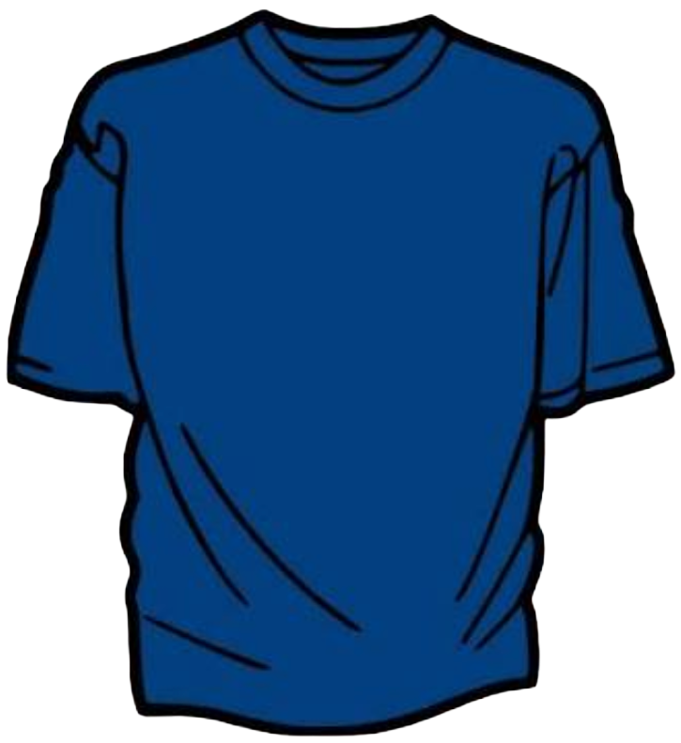
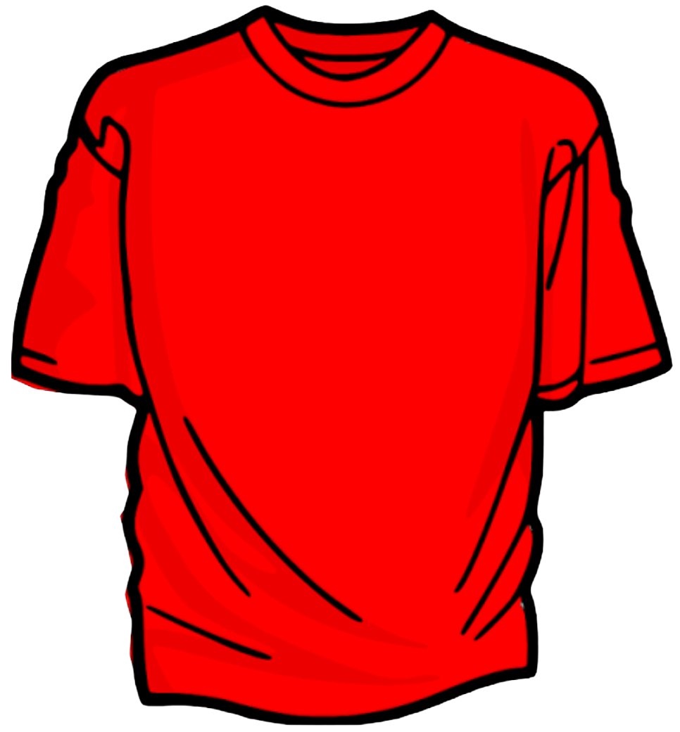
Ingroup/outgroup Endogrupo/exogrupo
How being part of a group shapes who we trust, who we favor, and how we treat outsiders
Cómo el pertenecer a un grupo moldea en quién confiamos, a quién favorecemos y cómo tratamos a los de afuera
Our brains automatically sort people into “us” or “them”, creating biases
El cerebro clasifica automáticamente a las personas como “nosotros” o “ellos”, lo que crea sesgos
An in-group is any social group you identify with or feel you belong to
Un endogrupo es cualquier grupo social con el que te identificas o al que sientes que perteneces
Famous study in 2006:
Children age 3-5 attending day care were assigned to wear blue or red for 3 weeks
Teachers treated both groups equally
Kids rated their own group more positively, thought they were more like the kids in their own group, and preferred their own group when choosing a new classmate to befriend
Estudio famoso de 2006:
A niños de 3 a 5 años en una guardería se les asignó usar azul o rojo durante 3 semanas
Los maestros trataron a ambos grupos por igual
Los niños calificaron a su propio grupo de forma más positiva, se sintieron más parecidos a los de su grupo y prefirieron a su propio grupo al elegir un nuevo compañero para hacer amistad
Notes:
Your brain creates these categories without your conscious permission, triggering automatic social categorization. These reactions happen in milliseconds, often before you have had time to form a conscious thought.

Slide 8
Power dynamics / hierarchies
Dinámicas de poder / jerarquías
Bases of power:
Reward power: Control over rewards others want
Coercive power: Ability to punish
Legitimate power: Position or role ("the boss")
Referent power: Influence from being liked, admired, or identified with (charisma)
Expert power: Influence from knowledge or skill
Informational power: Control over key information
Hierarchy shapes behavior through social roles:
Behavior is driven by social position and expectations, not just character
Why do hierarchies form?
Reduce conflict over who decides, coordinate group action, and are easy to read
Bases del poder:
Poder de recompensa: control sobre las recompensas que otros quieren
Poder coercitivo: capacidad de castigar
Poder legítimo: posición o rol ("el jefe")
Poder referente: por ser querido, admirado o alguien con quien la gente se identifica (carisma)
Poder experto: por el conocimiento o la habilidad
Poder informativo: control sobre la información clave
La jerarquía moldea el comportamiento a través de los roles sociales:
El comportamiento está guiado por la posición social y las expectativas, no solo por el carácter
¿Por qué se forman las jerarquías?
Reducen el conflicto sobre quién decide, coordinan la acción del grupo y son fáciles de leer

Slide 9

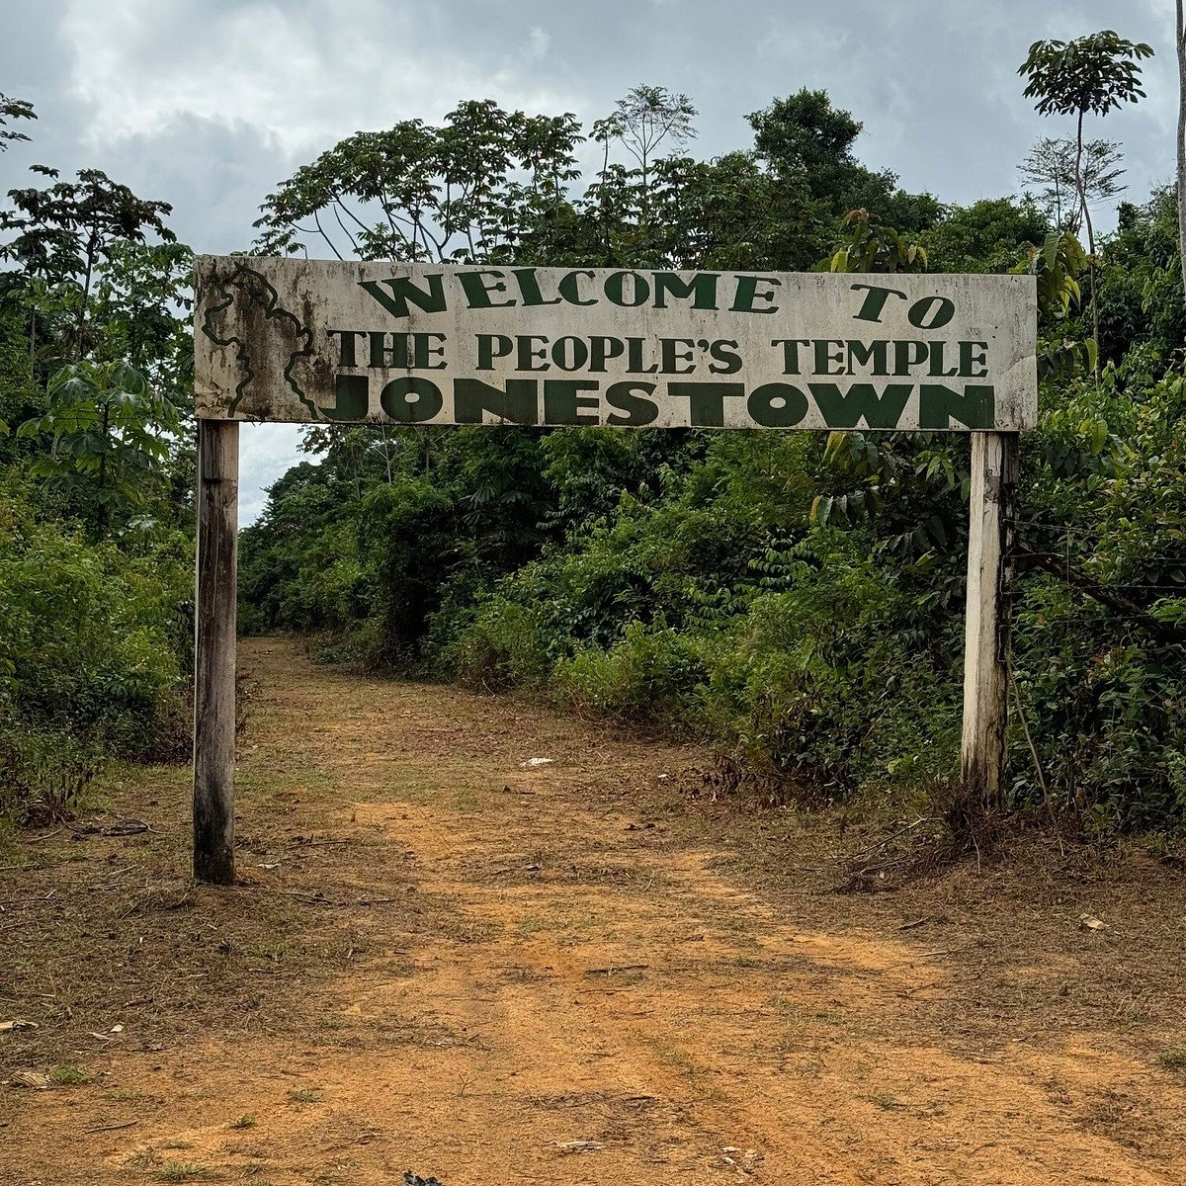
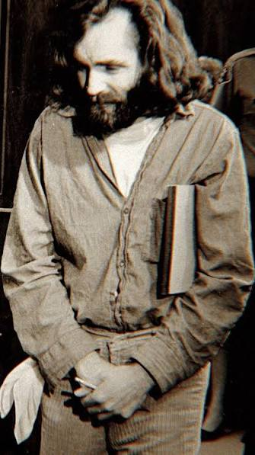
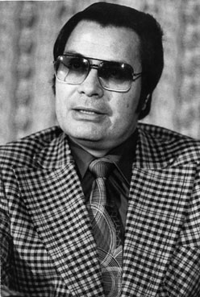
Cults Sectas
A cult is a high-control group organized around a charismatic leader
Una secta es un grupo de alto control organizado alrededor de un líder carismático
Cults exploit ordinary social forces: conformity and obedience
Las sectas explotan fuerzas sociales ordinarias: la conformidad y la obediencia
Recruitment targets people during vulnerable transitions (loss, isolation, a move), when the need for belonging and meaning is highest
El reclutamiento busca a personas en momentos de transición vulnerable (una pérdida, el aislamiento, una mudanza), cuando la necesidad de pertenencia y sentido es más alta
What defines a cult is not its beliefs but its methods: control, isolation, and suppression of dissent
Lo que define a una secta no son sus creencias, sino sus métodos: control, aislamiento y supresión del desacuerdo
The BITE model
Behavior control
Information control
Thought control
Emotional control
El modelo CIPE
Control del comportamiento
Control de la información
Control del pensamiento
Control emocional
Notes:
Behavior control (regulating what you do, where you live, who you see)
Information control (deception, restricting outside information, distrust of critics)
Thought control (loaded language, thought-stopping, black-and-white thinking)
Emotional control (guilt, fear, phobias about leaving)
Control del comportamiento (regular lo que haces, dónde vives, con quién te ves)
Control de la información (engaño, restringir la información externa, desconfianza hacia los críticos)
Control del pensamiento (lenguaje cargado, frenar el pensamiento, pensar en blanco y negro)
Control emocional (culpa, miedo, fobias a irse)
A cult leader often combines referent (charisma), legitimate (claimed spiritual authority), and coercive power

Slide 10
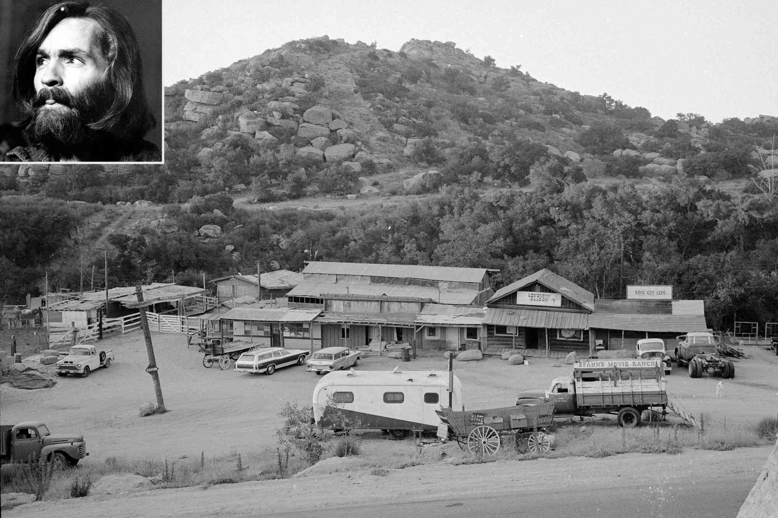
The Manson Family (1967–1969)
La Familia Manson (1967–1969)
Charles Manson built a following by offering belonging and spiritual enlightenment to drifting young people in 1960s California
Charles Manson formó un grupo ofreciendo pertenencia e iluminación espiritual a jóvenes a la deriva en la California de los años 60
~100 members, mostly young women
Unos 100 miembros, en su mayoría mujeres jóvenes
They lived at Spahn Ranch, an isolated, run-down movie set in the mountains outside LA, cutting them off from the outside world
Vivían en el rancho Spahn, un set de cine aislado y en ruinas en las montañas a las afueras de Los Ángeles, lo que los separaba del mundo exterior
Manson had nightly “LSD lectures”
Manson daba "sermones con LSD" cada noche
In August 1969, members killed seven people at Manson’s orders
En agosto de 1969, algunos miembros asesinaron a siete personas por órdenes de Manson
Notes:
Manson told his followers the murders would trigger an apocalyptic race war that he called "Helter Skelter", and that they would survive it and emerge to rule the world afterward. Manson took the phrase from a Beatles song (on the White Album) and built an elaborate apocalyptic prophecy around it. He preached that a violent race war between Black and white Americans was imminent and inevitable. He believed the murders, committed in a way designed to look like they were done by Black militants, would ignite this race war by provoking retaliation. During the war, Manson and the Family would hide in a "bottomless pit" in the desert (near Death Valley) and wait it out. He preached that Black Americans would win the war but would be unable to govern, and would then turn to Manson to lead. So the Family would emerge from hiding to rule the world.

